Slide 1
MBus: Enabling the Next Generation of Sensors and Systems
Pat Pannuto, Ye-Sheng Kuo, Ben Kempke, Yoonmyung Lee, Zhiyoong Foo, David Blaauw, Prabal Dutta
University of Michigan

Slide 2
How do you build an embedded system?
Goal: Build a “Temperature Sensor”

Slide 3
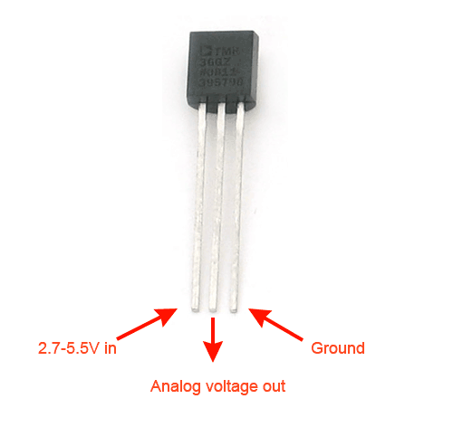
How do you build an embedded system?
Goal: Build a “Temperature Sensor”
Step 1:
Buy a temperature sensor

Slide 4
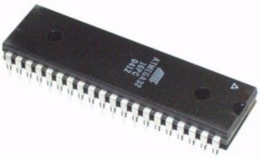
How do you build an embedded system?
Goal: Build a “Temperature Sensor”
Step 1: Buy a temperature sensors
Step 2: Add a microcontroller

Slide 5
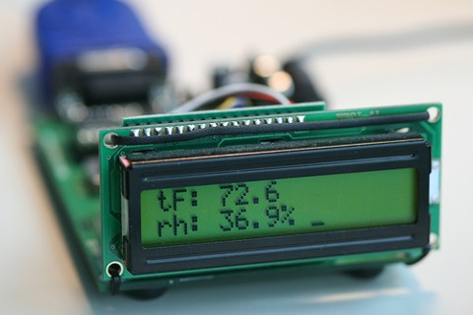
How do you build an embedded system?
Goal: Build a “Temperature Sensor”
Step 1: Buy a temperature sensors
Step 2: Add a microcontroller
Step 3: Add a display

Slide 6
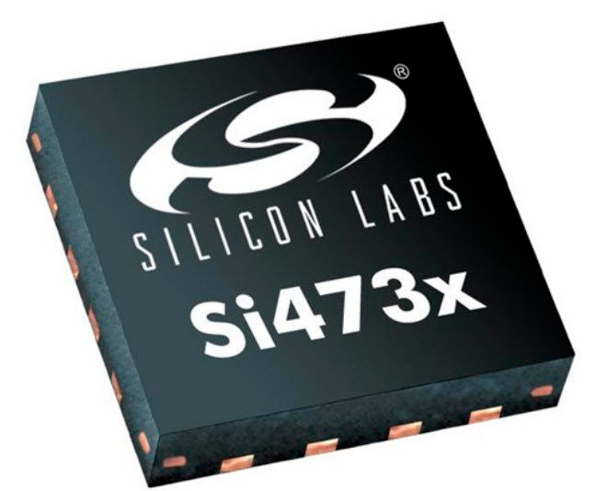
How do you build an embedded system?
Goal: Build a “Temperature Sensor”
Step 1: Buy a temperature sensors
Step 2: Add a microcontroller
Step 3: Add a display
Step 4: Add a radio

Slide 7
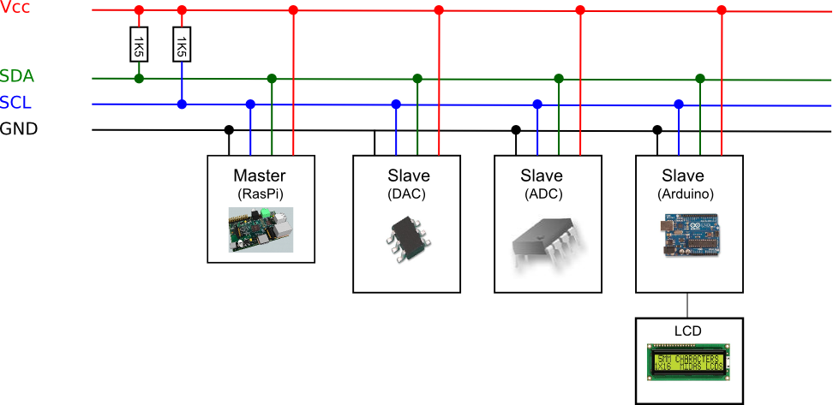
How do you build an embedded system?
Goal: Build a “Temperature Sensor”
Step 1: Buy a temperature sensors
Step 2: Add a microcontroller
Step 3: Add a display
Step 4: Add a radio
Step 5: Put it all together

Slide 8
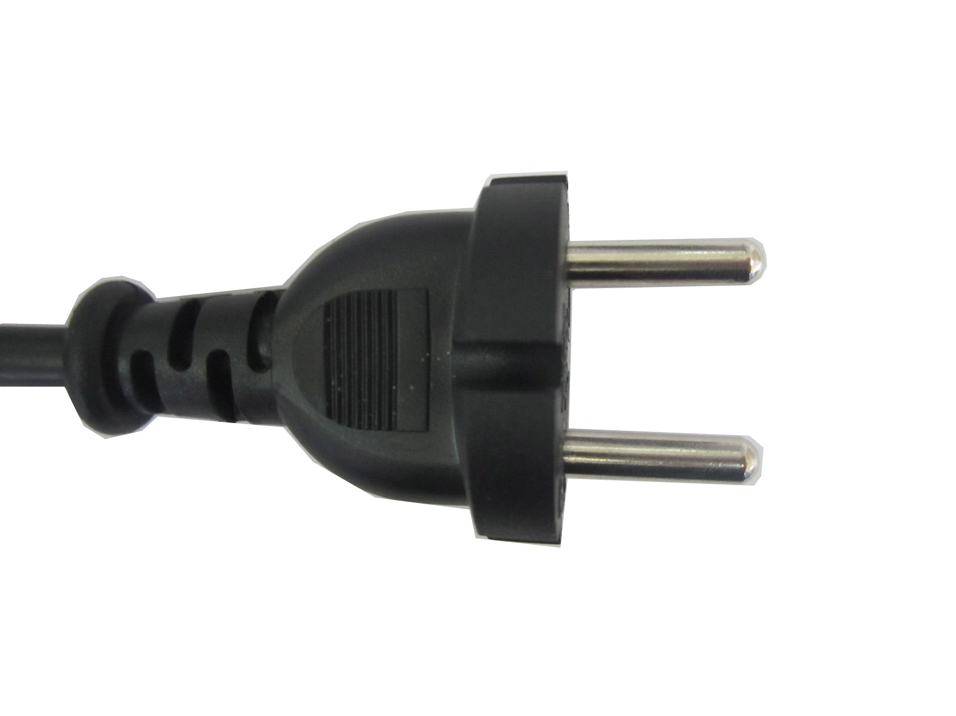
How do you build an embedded system?
Goal: Build a “Temperature Sensor”
Step 1: Buy a temperature sensors
Step 2: Add a microcontroller
Step 3: Add a display
Step 4: Add a radio
Step 5: Put is all together
Step 6: Plug it in.

Slide 9
How do you build an embedded system?
Goal: Build a “Temperature Sensor”
Step 1: Buy a temperature sensors
Step 2: Add a microcontroller
Step 3: Add a display
Step 4: Add a radio
Step 5: Put is all together
Step 6: Plug it in.
This is how you built an embedded system in 1980

Slide 10

Modern Technology “Cut the Cord”

Slide 11
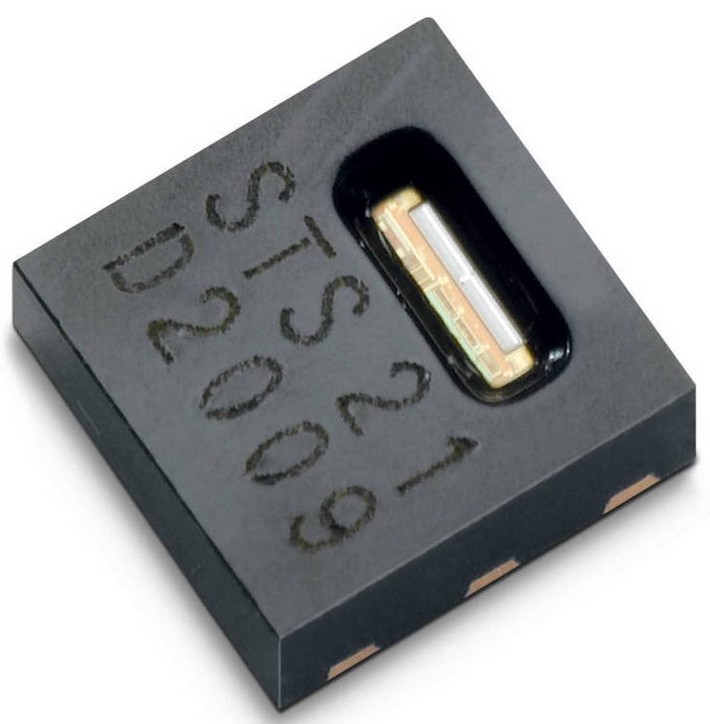
How do you build a low-power embedded system?
Goal: Build a “Temperature Sensor”
Step 1: Buy a low-power temperature sensor

Slide 12

How do you build a low-power embedded system?
Goal: Build a “Temperature Sensor”
Step 1: Buy a low-power temperature sensor
Step 2: Buy a low-power microcontroller

Slide 13
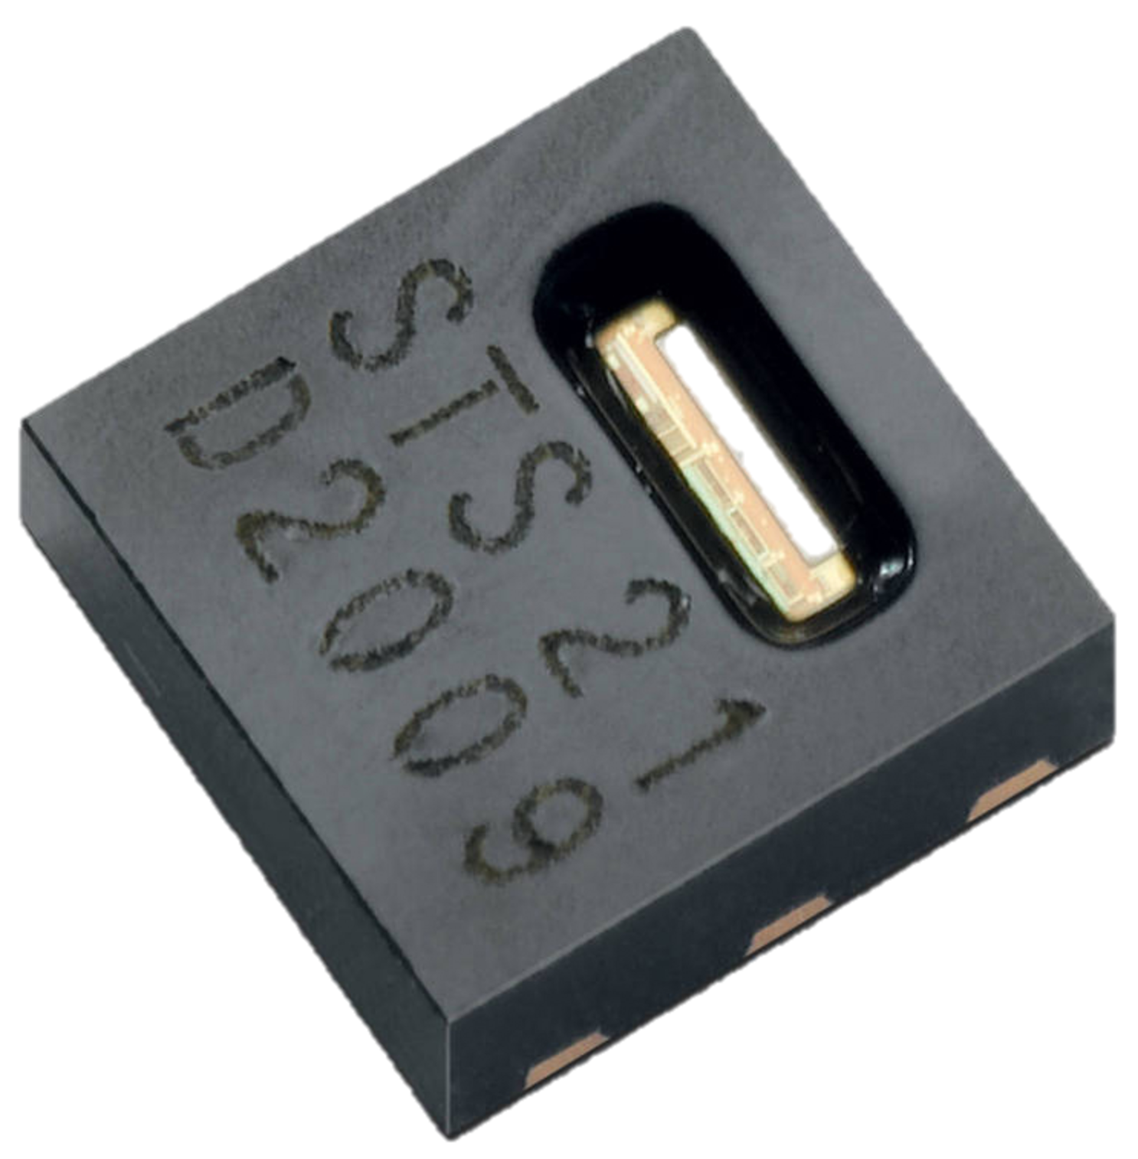


How do you build a low-power embedded system?
Goal: Build a “Temperature Sensor”
Step 1: Buy a low-power temperature sensor
Step 2: Buy a low-power microcontroller
Step 3: Outsource the display

Slide 14

How do you build a low-power embedded system?
Goal: Build a “Temperature Sensor”
Step 1: Buy a low-power temperature sensor
Step 2: Buy a low-power microcontroller
Step 3: Outsource the display
Step 4: Add low-power communication

Slide 15
How do you build a low-power embedded system?
Goal: Build a “Temperature Sensor”
Step 1: Buy a low-power temperature sensor
Step 2: Buy a low-power microcontroller
Step 3: Outsource the display
Step 4: Add low-power communication
Step 5: Put it all together

Slide 16

How do you build a low-power embedded system?
Goal: Build a “Temperature Sensor”
Step 1: Buy a low-power temperature sensor
Step 2: Buy a low-power microcontroller
Step 3: Outsource the display
Step 4: Add low-power communication
Step 5: Put it all together
Step 6: Add a battery

Slide 17
How do you build a low-power embedded system?
Goal: Build a “Temperature Sensor”
Step 1: Buy a low-power temperature sensor
Step 2: Buy a low-power microcontroller
Step 3: Outsource the display
Step 4: Add low-power communication
Step 5: Put it all together
Step 6: Add a battery
This is how you build an embedded system today

Slide 18
What does the next generation system look like?

Slide 19
What does the next generation system look like?
To understand the future, look to the past
?

Slide 20
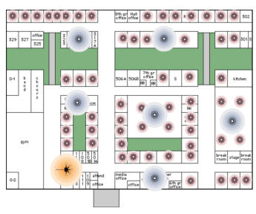
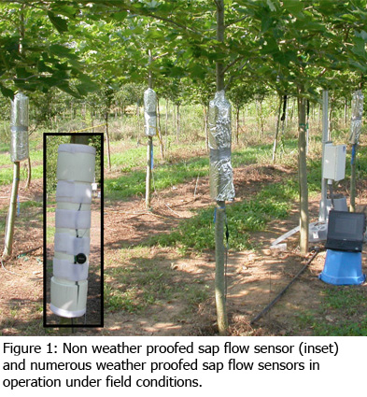
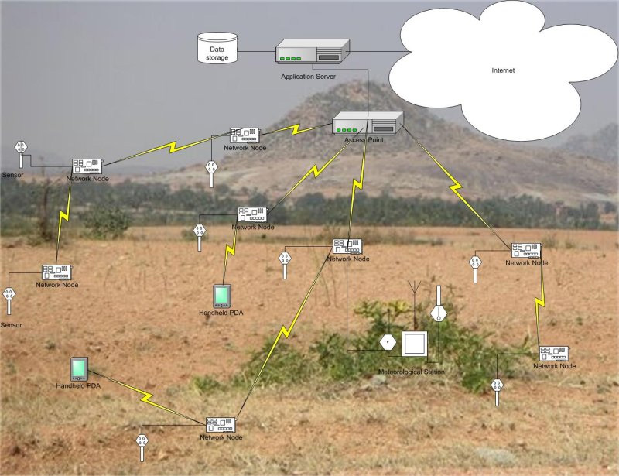
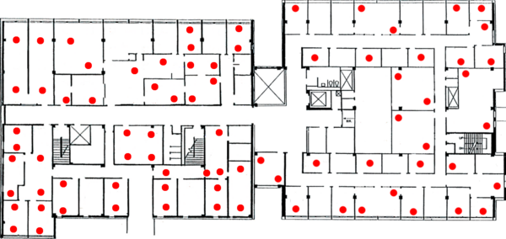
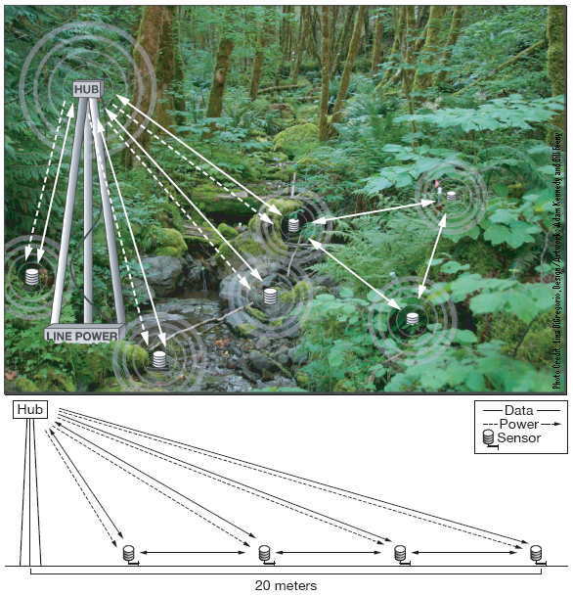
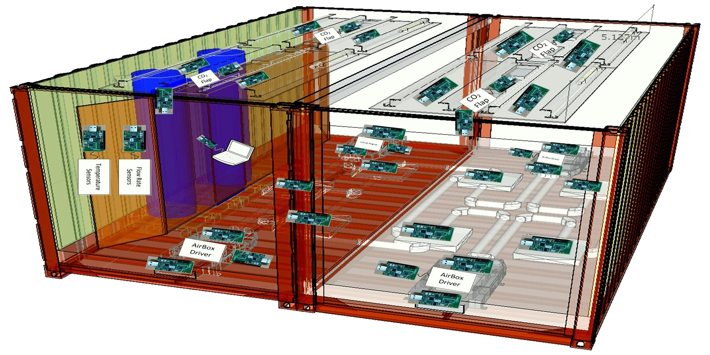
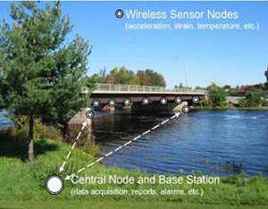
Cutting the cord let us put intelligence in more places

Slide 21
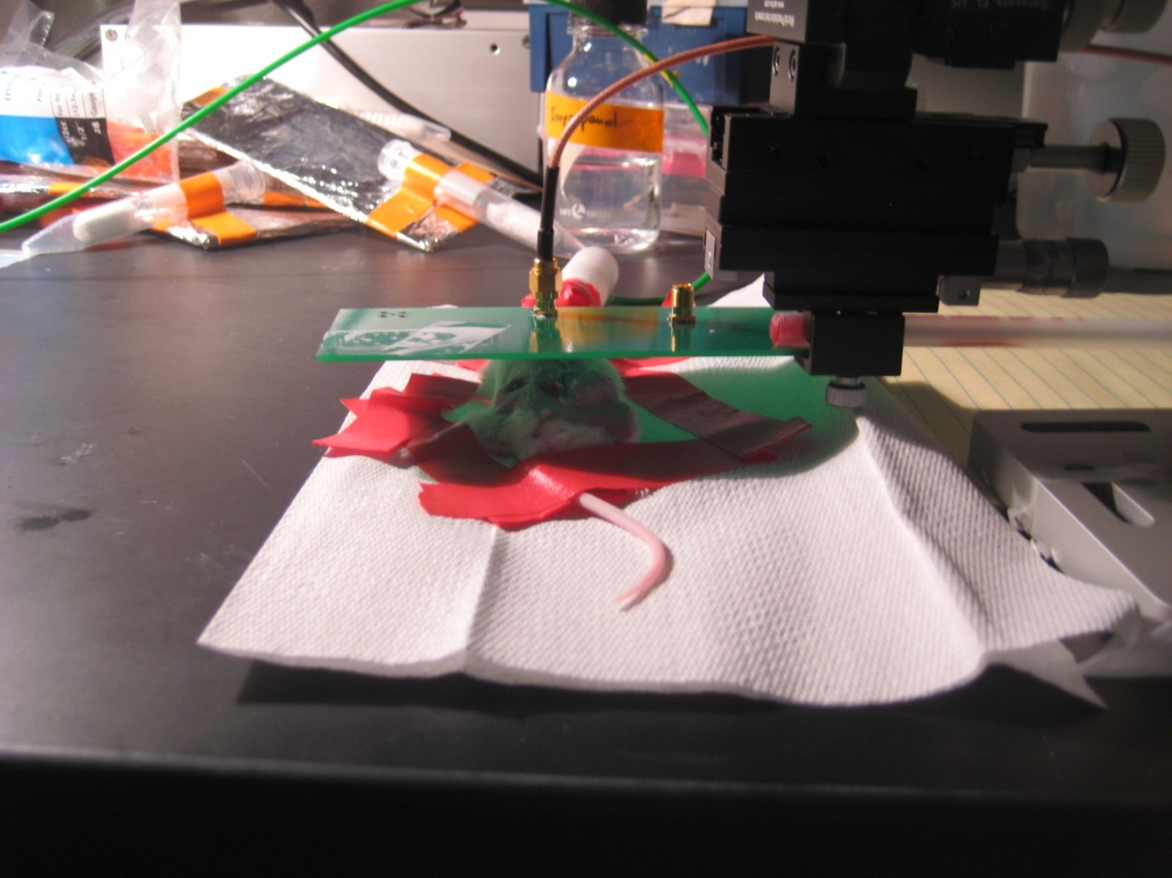
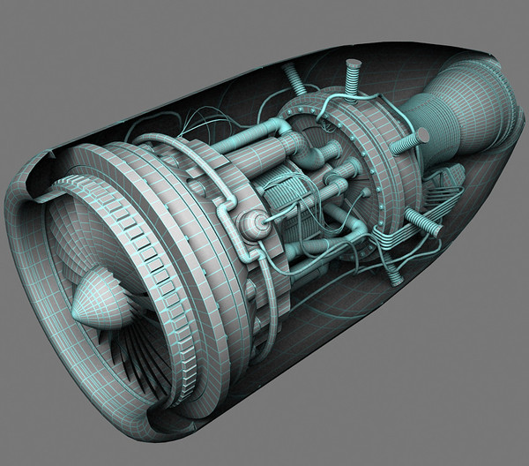
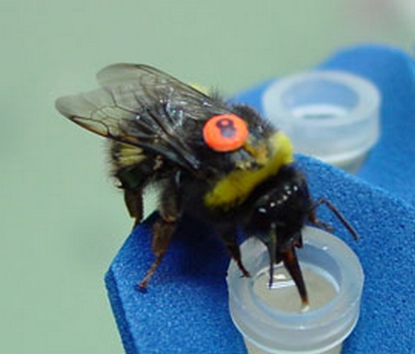
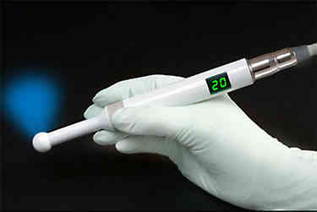
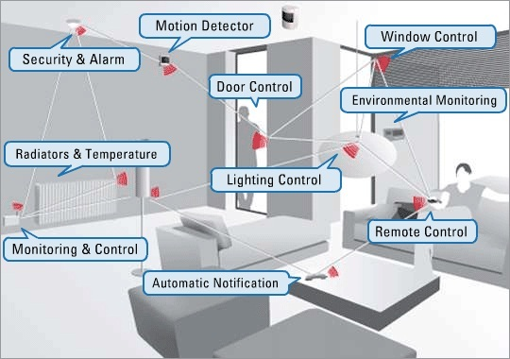
What niche does the next generation fill?
“Ubiquitous Computing”

Slide 22

Why don’t we have ubiquitous computing already?
Paid a heavy cost:
Batteries gave nodes a lifetime

Slide 23
Batteries Dominate Node Volume

Slide 24
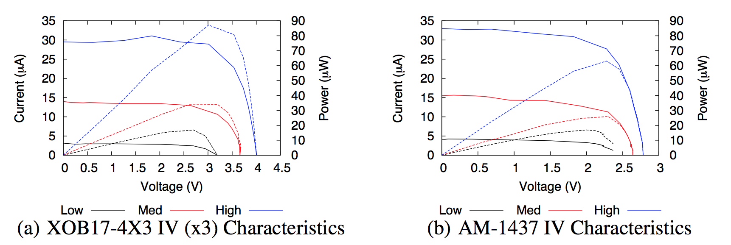
A new class of power emerges
“Next Generation” nodes will have
power budgets at or below 1 μW

Slide 25
How do you build an ultra-low power embedded system?
Goal: Build a “Temperature Sensor”

Slide 26
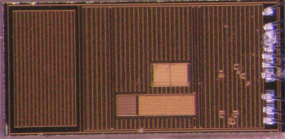
How do you build an ultra-low power embedded system?
Goal: Build a “Temperature Sensor”
Step 1: Build an ultra-low power temperature sensor
~10 pW standby, < 1 μW active

Slide 27
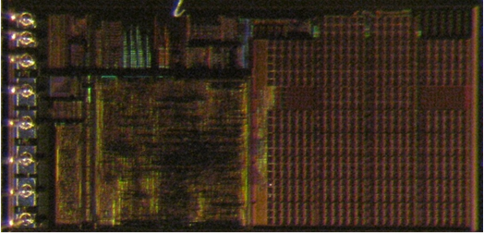
How do you build an ultra-low power embedded system?
Goal: Build a “Temperature Sensor”
Step 1: Build an ultra-low power temperature sensor
Step 2: Build an ultra-low power microcontroller
~1 nW sleep, ~1 μW active

Slide 28
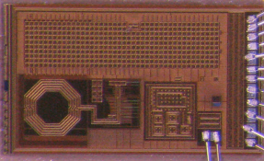
How do you build an ultra-low power embedded system?
Goal: Build a “Temperature Sensor”
Step 1: Build an ultra-low power temperature sensor
Step 2: Build an ultra-low power microcontroller
Step 3: Outsource the display
Step 4: Add ultra-low power communication
~10 pW standby, ~5 μW active

Slide 29
How do you build an ultra-low power embedded system?
Goal: Build a “Temperature Sensor”
Step 1: Build an ultra-low power temperature sensor
Step 2: Build an ultra-low power microcontroller
Step 3: Outsource the display
Step 4: Add ultra-low power communication
Step 5: Put it all together?

Slide 30
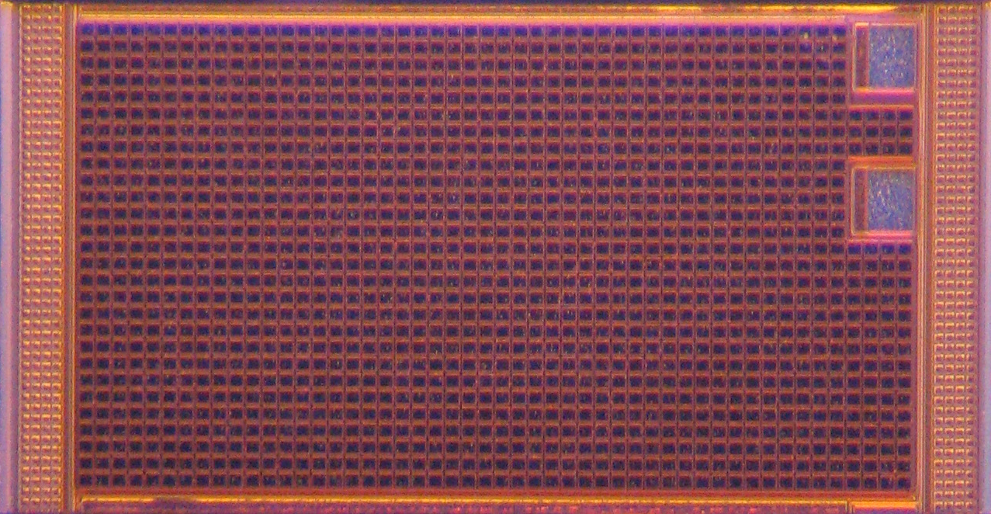
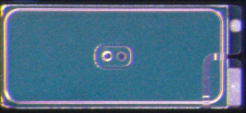
How do you build an ultra-low power embedded system?
Goal: Build a “Temperature Sensor”
Step 1: Build an ultra-low power temperature sensor
Step 2: Build an ultra-low power microcontroller
Step 3: Outsource the display
Step 4: Add ultra-low power communication
Step 6: Add power
Energy Harvesting Energy Storage

Slide 31
How do you build an ultra-low power embedded system?
Goal: Build a “Temperature Sensor”
Step 1: Build an ultra-low power temperature sensor
Step 2: Build an ultra-low power microcontroller
Step 3: Outsource the display
Step 4: Add ultra-low power communication
But How To Put It All together?
Step 6: Add power
Energy Harvesting Energy Storage

Slide 32
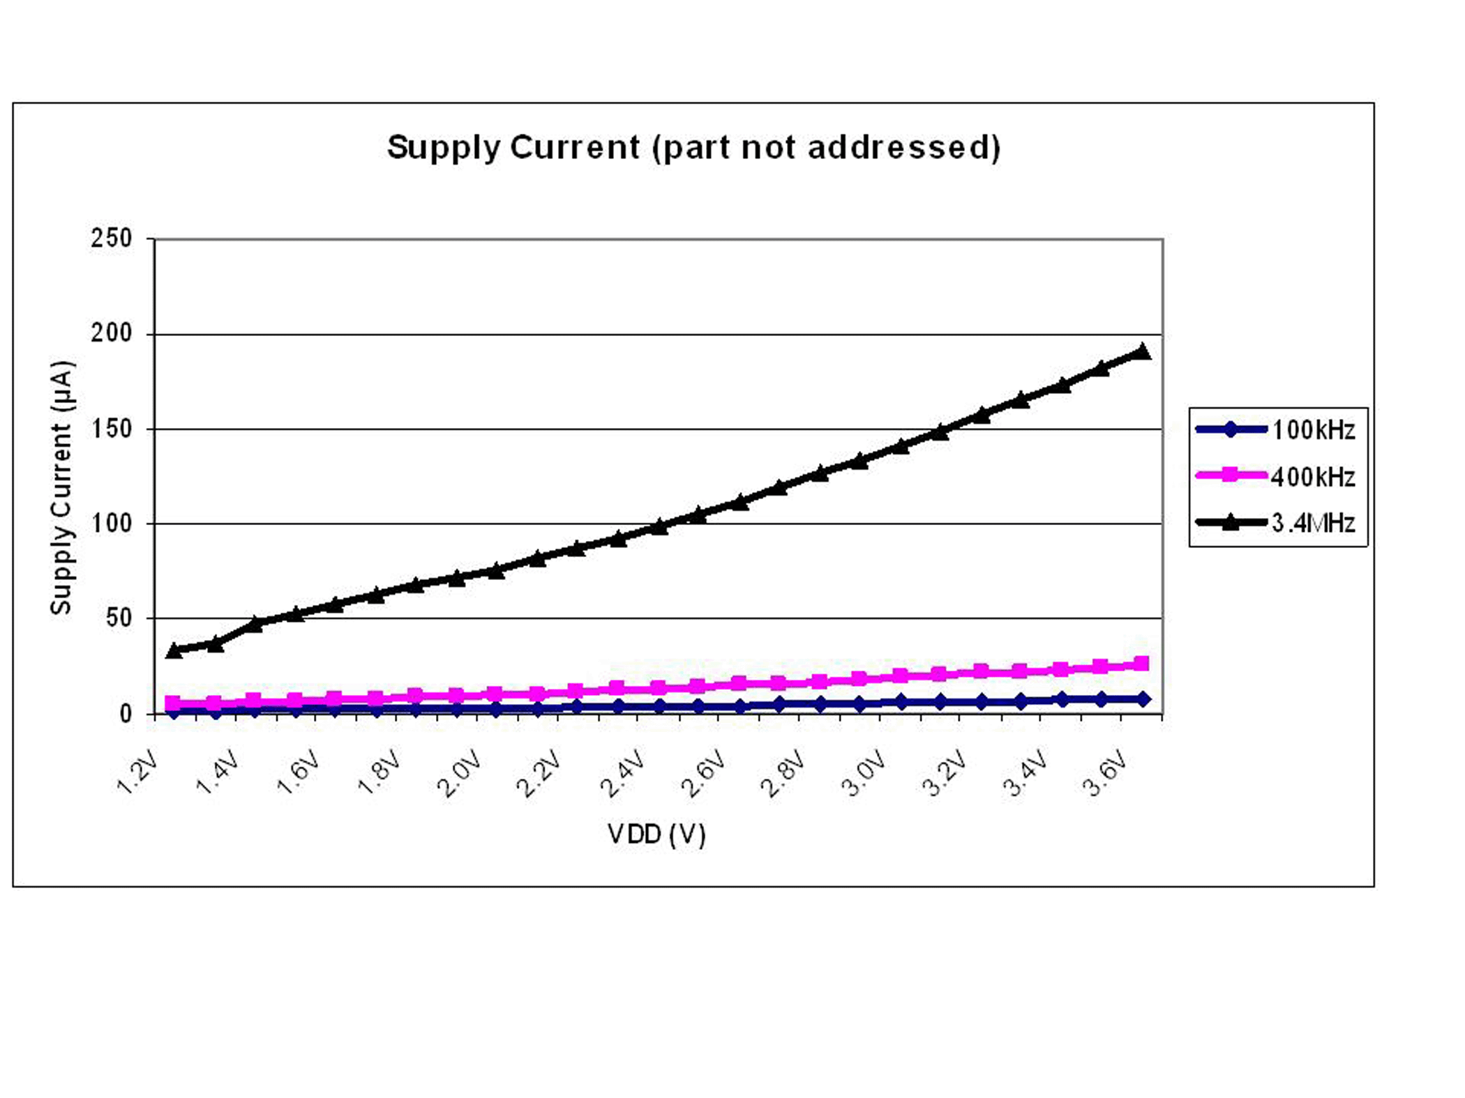
Composing ultra-low power systems: Why not open collectors?
I2C, CAN, SMBus…
Pros
Multi-master
Low wire count (~2)
Cons
Pull-up resistor burns power (order μW)
Speed / power tradeoff

Slide 33
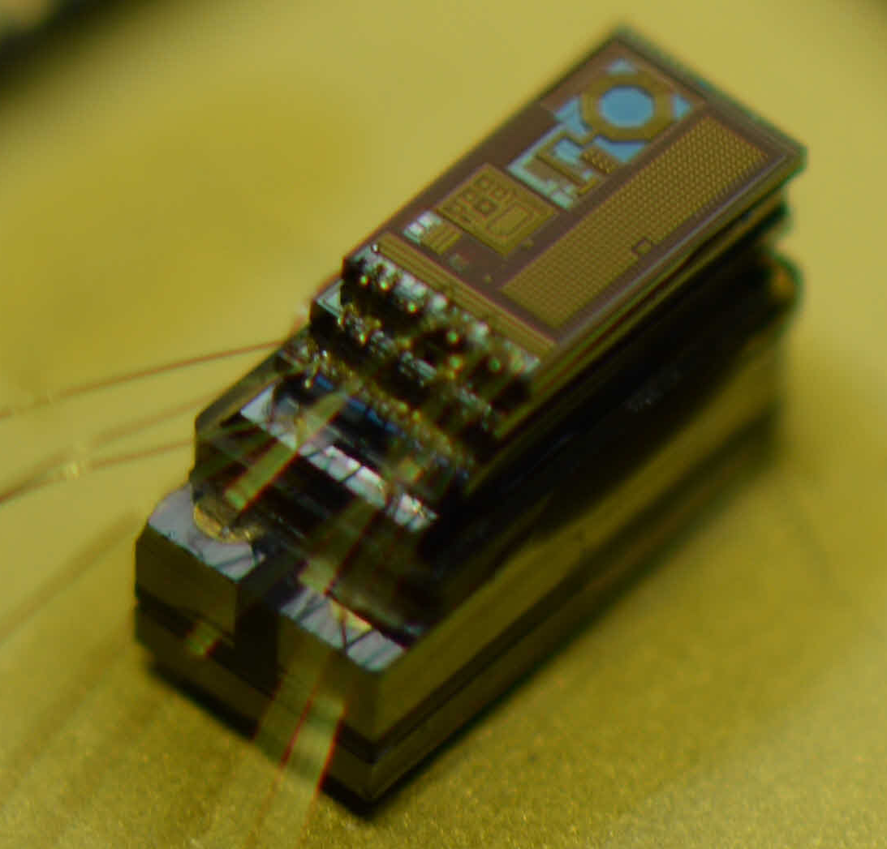
Composing ultra-low power systems: Why not “pure digital” buses?
SPI
Pros:
Single-ended
Low (no) ACK overhead
Cons:
Single master
3 + N wires, N is chip count
Wires can dominate size
No ACK mechanism

Slide 34
We built a new bus (and we actually needed it)
MBus
Pros:
Multi-master
Single-ended
Low wire count (4)
Reliable reset mechanism
Low ACK overhead
Cons:
Topological Priority
MBus System Topology

Slide 35
MBus Enables ultra-low power systems
MBus is a power-aware bus
So we can build power-oblivious systems

Slide 36
Ultra-low power computing turns things OFF
How are ultra-low power chips ultra-low power?
They turn OFF (power gating)

Slide 37
Global State is Hard – So Don’t Do It
MBus guarantees message reception regardless of target chip power state
Power-aware bus

Slide 38
MBus Insight: Waking Nodes
During arbitration, a node is either:
Awake or asleep
Sleeping nodes will never arbitrate

Slide 39
MBus Insight: Interrupt Procedure
In normal operation, DATA is always slower than CLOCK
Extremely reliable
“Independent” circuit

Slide 40
So how DO you build an embedded system?
MBus

Slide 41
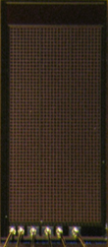
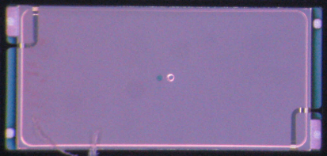
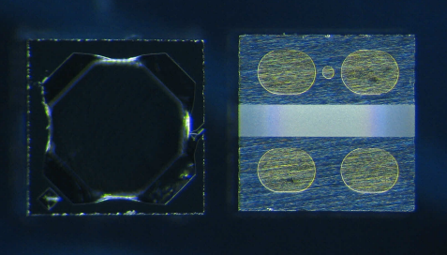
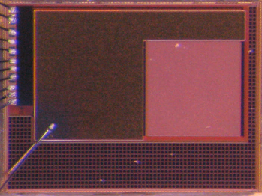
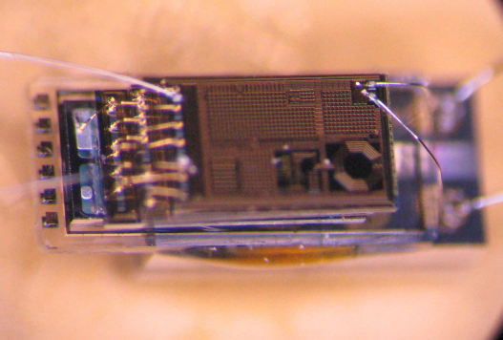
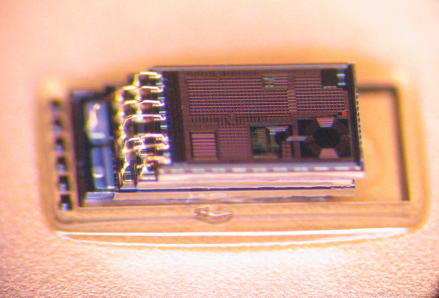
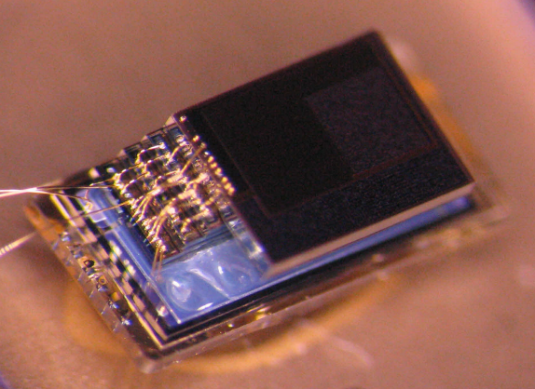
MBus enables modular construction of ultra-low power systems
Control/
PMU
Decap
Temp Sensor
Radio
+ CDC
2 uAh Battery
5 uAh Battery
MBus
MEMS
P. Sensor
Motion Detection/ Imager
Pressure Sensing
Temp. Sensing
Visual Sensing

Slide 42







The “modules” that made MBus possible
Pat Pannuto
Ye-Sheng Kuo
Ben Kempke
Yoonmyung Lee
Zhi Yoong Foo
Prabal Dutta
David Blaauw

Slide 43
How do you build an ultra-low power embedded system?
?

Slide 44
How do you power an ultra-low power embedded system?
?

Slide 45
How do you power an ultra-low power embedded system?
?

Slide 46
How do you power an ultra-low power embedded system?
?

Slide 47
How do you power an ultra-low power embedded system?
?
130 nm Solar Array
Answer: Build an efficient energy harvester

Slide 48
How do you build an ultra-low power embedded system?
?

Slide 49
How do you build an ultra-low power embedded system?

